Slide 1
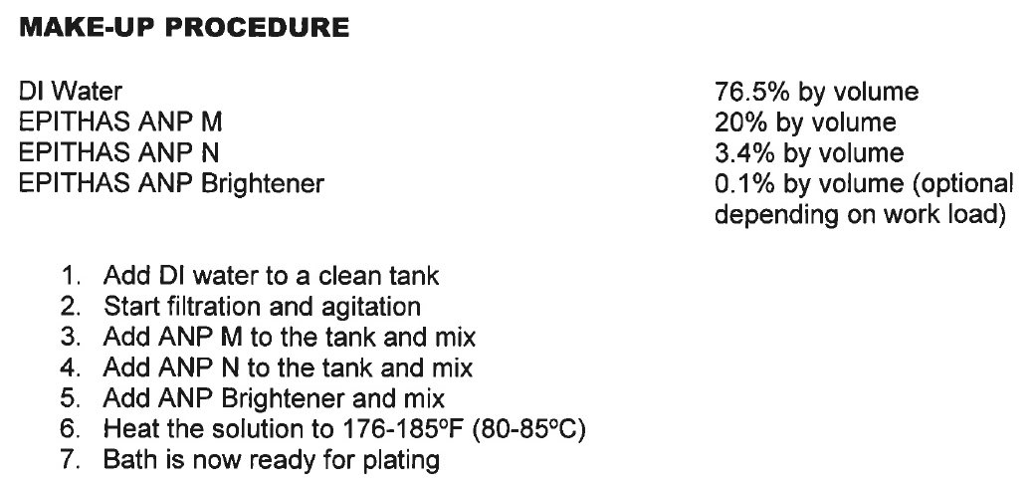
→8.0325L H₂O, 2.1 L ANP-M, 0.357L ANP-N, 10.5mL Brightener →pH ~4.85
use 5% H₂SO₄ to bring down to pH 3.98, note final pH
10.5 L Ni(P) bath
fresh
→Take-out OLD 2.5L mixture, measure pH
→Add NEW 2.5L Ni(P) mixture:
1,913 mL H₂O
500 mL ANP-M
85 mL ANP-N
2.5 mL Brightener
→Filter, measure pH (~4.3 – 4.2) AND using 5% H₂SO₄, bring pH down to about 3.98
2.5 L Ni(P) bath
for replenishment
after every 30++ wafer runs

Slide 2
1 L Ni(P) bath
fresh
→765 mL H₂O, 200 mL ANP-M, 34 mL ANP-N, 1mL Brightener →pH ~4.85
use 5% H₂SO₄ to bring down to pH 3.98, note final pH

